Slide 1

Probabilistic Anomaly Scoring
for Explainable Digital Forensic Triage
Submitted by:
Under the Guidance of:
Institution:
Nitya Sanguri (2023492)
Dr. Rehan
Graphic Era Deemed to be University
Adarsh Bhandari (2023980)
Assistant Professor
Dept. of CSE · Team ID MP2026CSE75

Slide 2


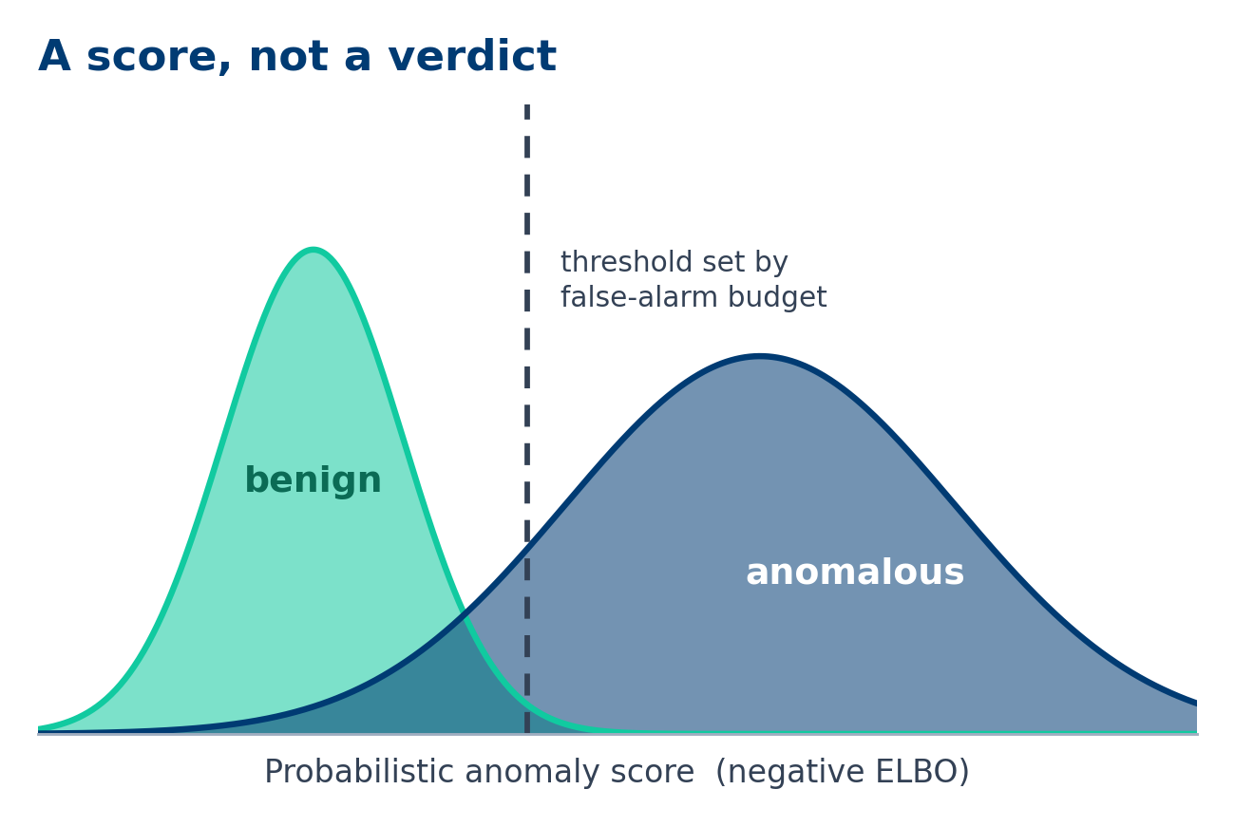
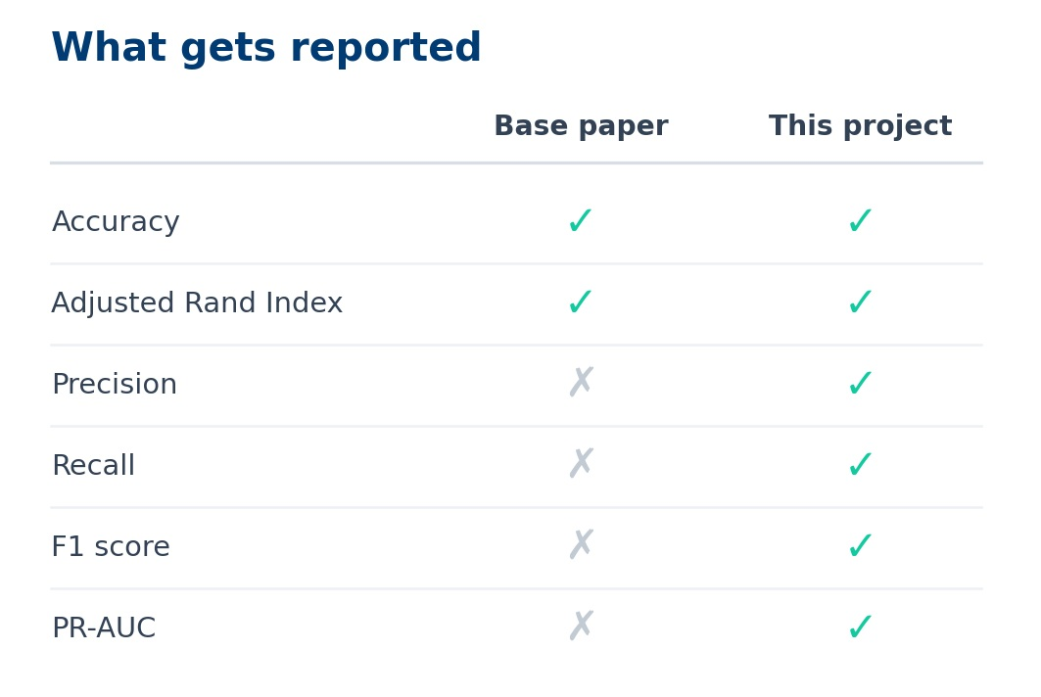
Introduction
•
A single seized workstation yields terabytes of disk and gigabytes of RAM. Deciding what to examine first is called triage.
•
Obfuscated, packed and fileless malware can leave nothing on disk while staying fully resident in RAM.
•
The base paper uses CIC MalMemAnalysis-2022, 55 memory features from one machine.
•
Dunsin et al. find AI improves forensic throughput, but adoption is limited by weak interpretability.

Slide 3





Problem Statement
No Anomaly Metrics
A Hard Threshold
One Machine Only
The base paper reports aggregate accuracy and ARI only. There is no precision, recall or F1 for the anomaly class, which is the class an examiner actually cares about.
The autoencoder flags an artefact when reconstruction error crosses a hand-picked cut-off. The examiner gets a verdict with no calibrated measure of uncertainty.
Evidence comes from a single attacked computer, one OS and one tool, and the model is fitted and scored on that same data, so nothing shows the method generalises.

Slide 4

Literature Review & Research Gap
What Has Been Done
What Is Missing
•
Supervised benchmarks: Carrier et al. 99%, Dener et al. 99.97%, Öztürk and Hızal 99.99% binary on CIC MalMemAnalysis-2022.
•
No anomaly-class metrics: Only aggregate accuracy and ARI are reported, so recall on the class that matters is unknown.
•
Unsupervised XAI: Khalid et al. (2025): Isolation Forest, an autoencoder and SHAP. Our base paper.
•
No data split: Models are fitted and scored on the same rows.
•
SHAP works well here: The base paper's SHAP plots gave clear, readable feature attributions on this data, which is why we build on them rather than replace them.
•
One dataset, one machine: All evidence comes from a single attacked computer on one OS with one tool, sampled every 10 seconds, so generalisation is untested.

Slide 5
Base Paper vs. Proposed Work
Base Paper (Khalid et al., 2025)
Proposed Work
•
Autoencoder + threshold: An artefact is flagged when reconstruction error crosses a hand-picked cut-off.
•
VAE + probabilistic score: The negative ELBO gives a likelihood instead of a cut-off. The AE is run first as the comparator.
•
Accuracy and ARI only: No precision, recall or F1 for the anomaly class.
•
Full metric set: Precision, recall, F1 and PR-AUC for the anomaly class.
•
One dataset, no split: 58,596 rows from one machine on one OS, fitted and scored on the same data, with no train, validation or test partitions.
•
Three datasets, split properly: Train, validation and test partitions, the protocol repeated on Dumpware10 and CICIoT2023, and SHAP carried onto the VAE score.

Slide 6
Project Objectives
Reproduce the Baseline: Re-run the base paper's autoencoder on CIC MalMemAnalysis-2022.
Focus 1, Probabilistic Score: Replace the autoencoder with a VAE so each artefact gets a likelihood, not a threshold.
Focus 2, SHAP Explainability: Extend the base paper's SHAP analysis onto the VAE score to show which features drove it.
Complete the Metrics: Report precision, recall, F1 and PR-AUC for the anomaly class, not accuracy alone.
Split the Data Properly: Train, validate and test on separate partitions instead of scoring on the training rows.
Test Generalisation: Repeat the protocol on Dumpware10 and CICIoT2023 to look beyond one machine and one OS.

Slide 7
Datasets Used
Dataset | Role in This Project
CIC MalMemAnalysis-2022 | The base paper's dataset. 58,596 rows, 55 VolMemLyzer-V2 memory features, captured from one machine on one OS and sampled every 10 seconds.
Dumpware10 | Memory dumps of 11 malware families rendered as images. Second modality, used with a convolutional VAE.
CICIoT2023 | CIC network traffic dataset. Third modality, testing whether the approach holds outside memory features.
Why Three | The base paper evaluates on one dataset only, so nothing in it shows that the method transfers to other evidence or other machines.
Data Handling | Train, validation and test partitions fixed once and reused by the AE and the VAE, so both models are compared on identical data.

Slide 8
Methodology & Working Flow
4. Measure & Explain
2. AE Baseline
AE against VAE on anomaly-class metrics, SHAP on the VAE score, then repeated on the other two datasets.
The base paper's autoencoder and Isolation Forest reproduced on the proper split.
1. Prepare & Split
3. Variational AE
Labels withheld, features standardised, and separate train, validation and test partitions created.
Encoder maps to a latent distribution; the negative ELBO becomes a probabilistic anomaly score.

Slide 9
Technologies & Tools Used
Layer | Tools & Libraries
Compute & Environment | Core i7 / Ryzen 7 class CPU, 32-64 GB RAM, NVMe SSD, RTX 3060 (8 GB+ VRAM); Ubuntu 22.04 or WSL2, Docker, Python 3.10+
Forensic Parsing | Volatility 3, VolMemLyzer-V2, Zeek, Suricata, Wireshark / TShark, Scapy, dpkt
Models | PyTorch or TensorFlow / Keras for the autoencoder, the variational autoencoder and the convolutional VAE
Baselines & Metrics | Scikit-learn: Isolation Forest, GMM, K-means, DBSCAN, PCA, StandardScaler, train_test_split and the metric functions
Explainability & Output | SHAP model-agnostic Explainer; Pandas, NumPy, Parquet; Matplotlib and Seaborn for PR curves and confusion matrices

Slide 10






Key Contributions
Probabilistic Score
SHAP Explainability
Honest Evaluation
Focus 1. A variational autoencoder replaces the autoencoder, so the output is a likelihood-based score rather than a hand-picked reconstruction threshold.
Focus 2. The base paper's SHAP analysis worked well on this data, so it is carried onto the VAE score to show which memory features drove each decision.
Separate train, validation and test partitions, anomaly-class precision, recall and F1, and replication on two further datasets.

Slide 11
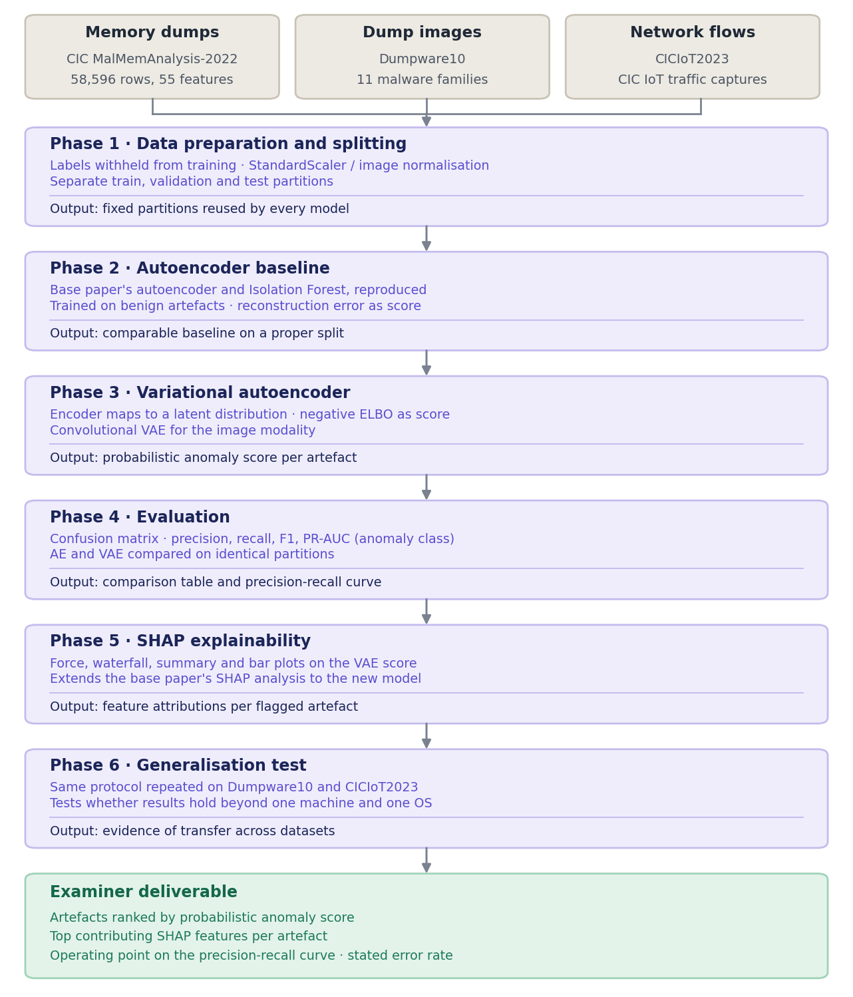
Methodology Pipeline
Six Phases, Three Datasets
Three datasets feed one protocol: the base paper's memory features, memory dumps rendered as images, and CIC network traffic.
Phases 1 to 3 split the data and fit both models: the autoencoder first, reproducing the base paper, then the variational autoencoder that replaces its threshold with a likelihood score.
Phases 4 to 6 measure the anomaly class properly, explain each decision with SHAP, and repeat the protocol on the other two datasets.

Slide 12

Expected Outcomes
AE vs. VAE, Measured
4
Both models run on identical partitions and are scored on the anomaly class, so the gain from moving to a probabilistic score is a number rather than a claim.
Explained and Generalised
Base-Paper Limits Addressed
SHAP attributions for every flagged artefact, plus the same protocol repeated on Dumpware10 and CICIoT2023 to show it holds beyond one machine.

Slide 13
Conclusion & Limitations
Digital forensic triage needs machine learning that works without labels and produces a score an examiner can defend. Taking Khalid et al. (2025) as the base paper, this project addresses four of its limitations: no anomaly-class metrics, a single dataset, no train/validation/test split, and evidence from one machine on one OS. Focus 1 replaces the autoencoder with a variational autoencoder, giving a probabilistic score instead of a hand-picked threshold. Focus 2 extends the base paper's SHAP explainability onto that score.
Stated Limitation: The datasets carry no timestamps, so temporal generalisation cannot be tested here.

Slide 14
Thank you
Project Team:

